Slide 1


IST654 Group - 8

Slide 2

“ Meeting Makers provides services to assist organizations in organizing conferences and meetings”
LETS GET STARTED

Slide 3

Agenda
BUSINESS BACKGROUND
CURRENT ISSUES
SCOPE
REQUIREMENTS
ANALYSIS
USER INTERFACE DESIGN
LESSONS LEARNED
PROBLEMS & DIFFICULTIES
EXPERIENCE GAINED

Slide 4
BUSINESS BACKGROUND
Meeting Makers offers services to help businesses and groups plan and organize conferences and meetings.
After asking for basic information about the desired city, dates anticipated the number of attendees, etc., Meeting makers prepares a bid for the services where it gathers and estimates on a variety of services.
Two to three price range options are sent to the client to view.
Once the bid has been provided to the client, the project manager photocopies the information about the extracurricular activities, returns the original brochure to the staff and places all bid information into a file that all the team members working on that case at Meeting Makers have access to.

Slide 5
CURRENT ISSUES
Hotels are not willing to place holds.
Penalties are charged as Project Managers forgot to cancel hotel holds.
Graphic Designer face bid preparation difficulties due to lack of records.
Nearby city additional activities are not recorded in files.
Software or files of the company are not shared on the company network.
Low productivity of staff.
Training limitations of staff w.r.t. MS Excel and Word.
Excess workload causing time limitations to explore and learn for staff.
Loss of customers due to inaccuracy of bids, and lack of care.
Issue in primary key integrity causing database problems.

Slide 6

SCOPE
To build an Information System that can accurately retrieve data and calculate bids and efficiently handles meetings, hotel bookings, conferences, and other activities for Meeting Makers.

Slide 7
FUNCTIONAL REQUIREMENTS
Cloud-based system to store and simultaneously edit all the documents.
Restructure the relational model to solve primary key problems and make all databases cloud-based.
System to set and receive reminders to book and cancel hotel reservations and alert project managers.
Having one catalog format for brochure cost estimation in the database.
Program to track, predict and eliminate bidding and booking errors.

Slide 8
NON-FUNCTIONAL REQUIREMENTS
A centralized software or web interface with explicit access to manage all the functional systems and databases.
Brochure cost estimation and the design system should be managed by a team, instead of an individual.
Arrange workshops to make the employees more acquainted with the information system.

Slide 9
ANALYSIS
Context DFD
Level-0 DFD
Basic ERD
EERD
UML

Slide 10
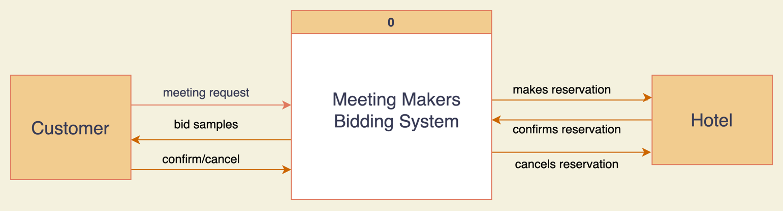
1. Context DFD
Context DFD:

Slide 11
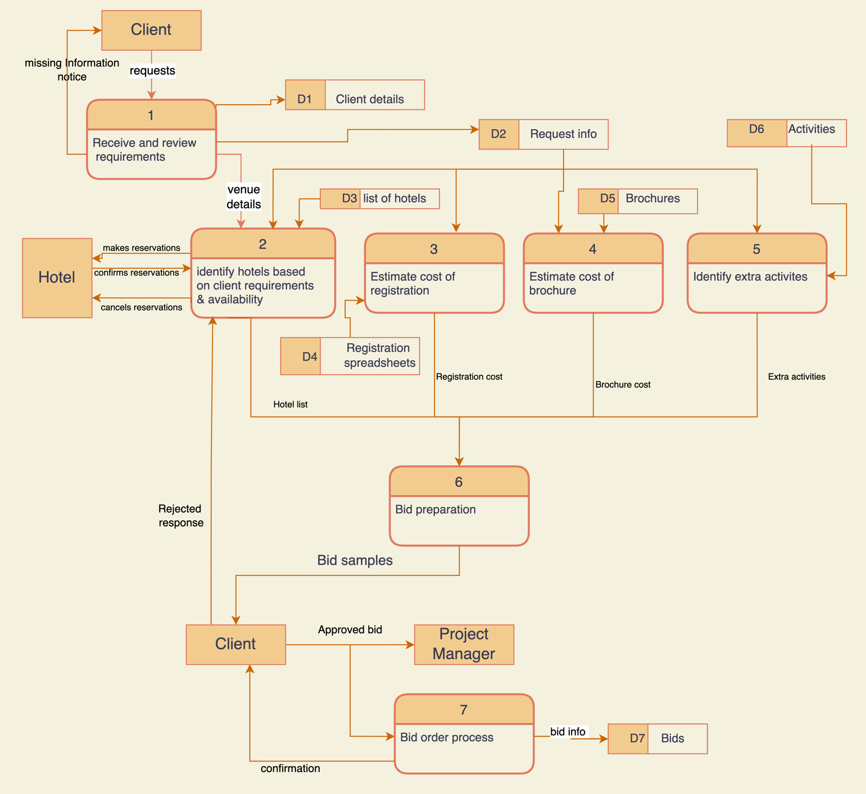
2. Level-0 DFD

Slide 12
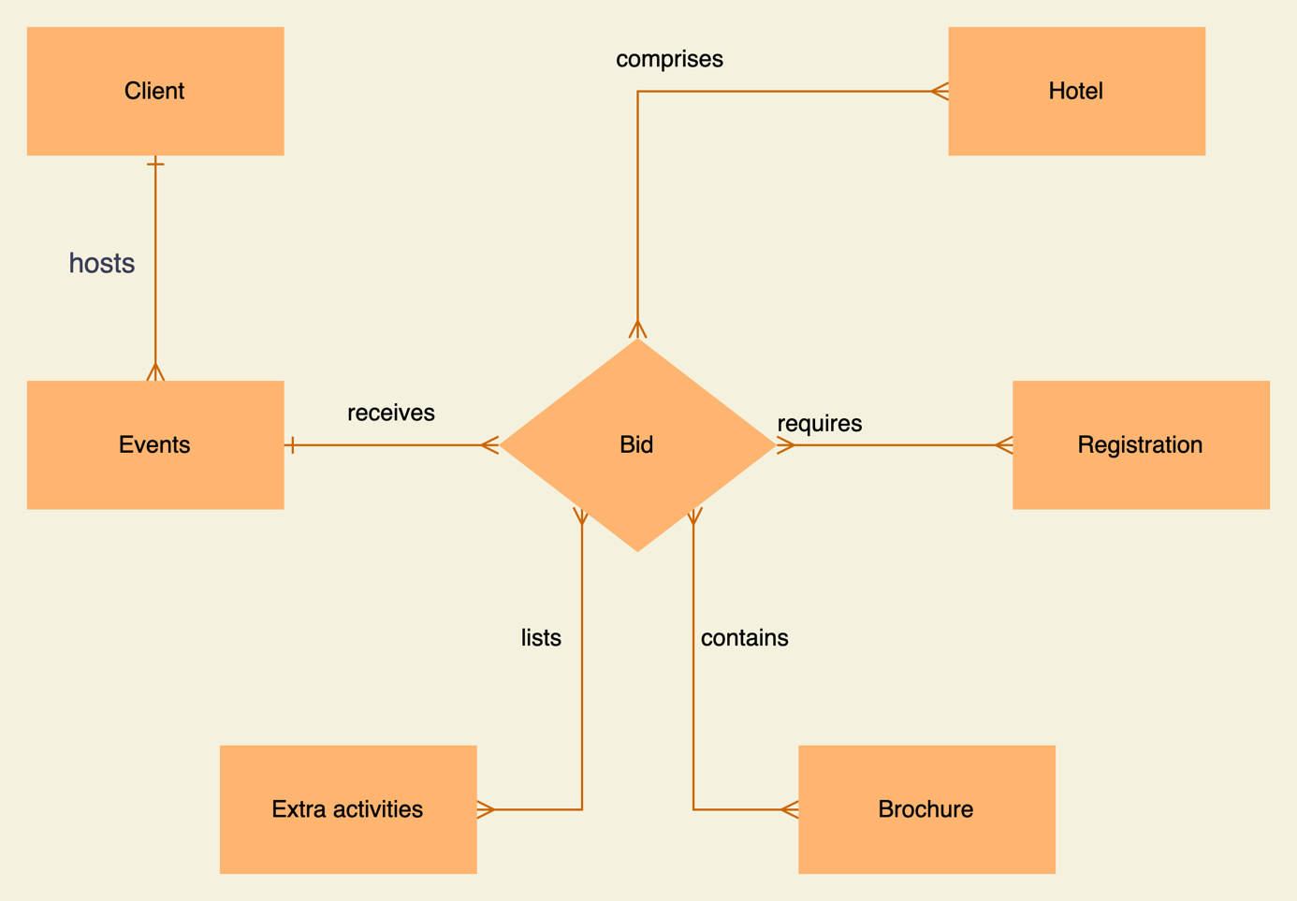
3. Basic ERD

Slide 13
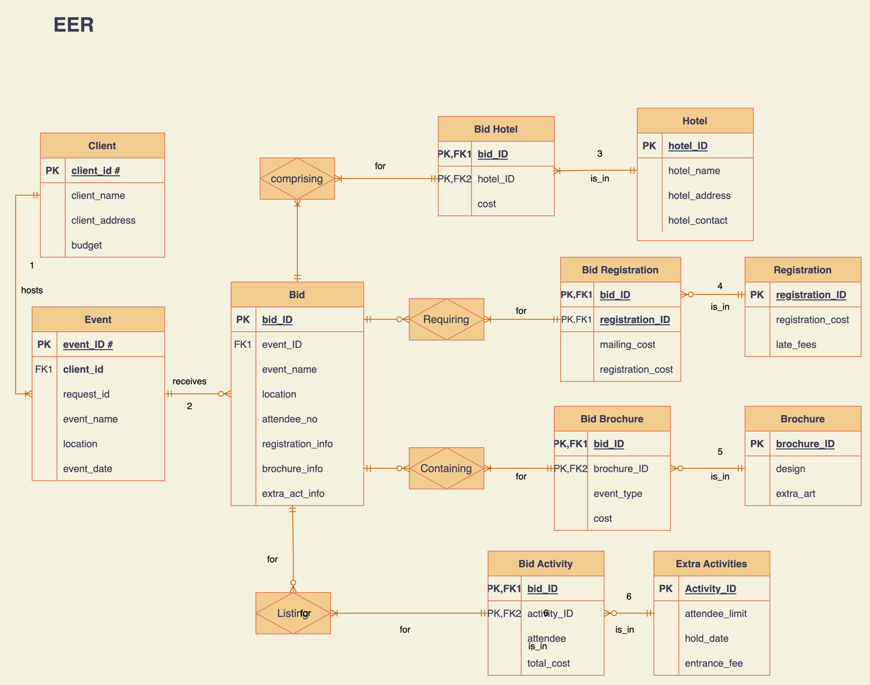
4. EERD

Slide 14
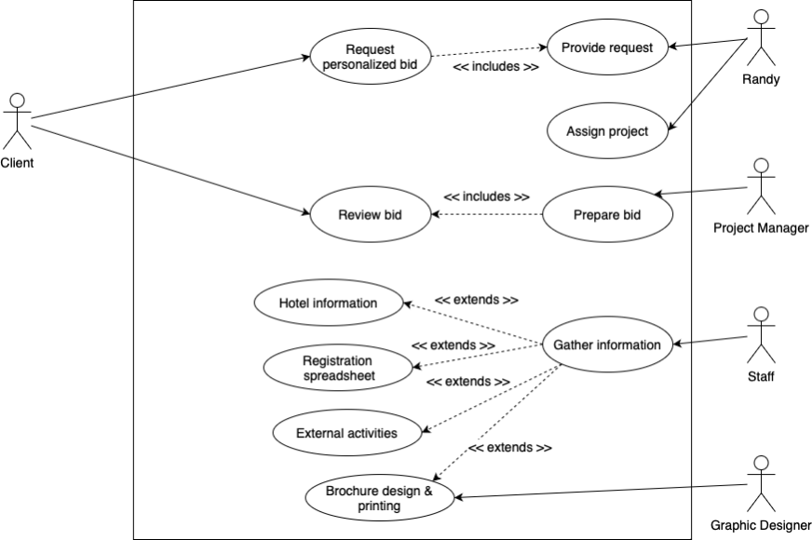
5.1 UML – Use Case

Slide 15
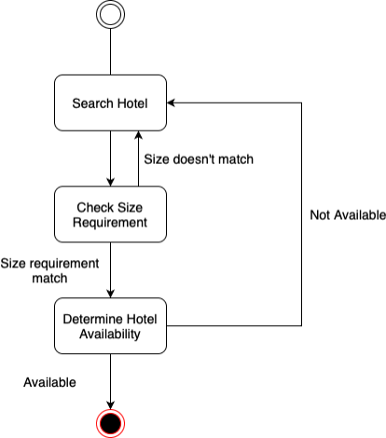
5.2 UML – State Transition

Slide 16
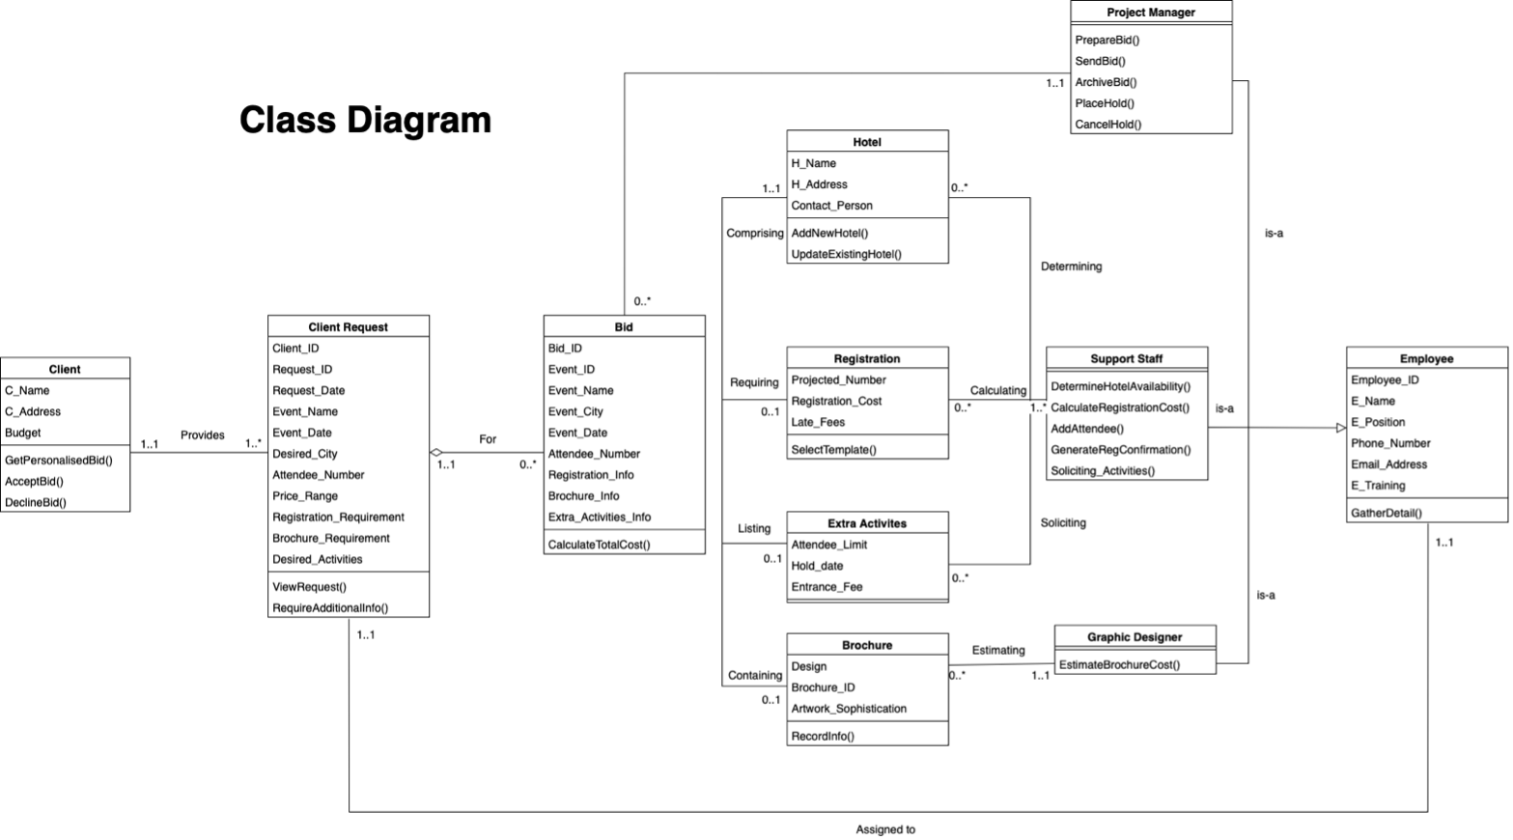
5.3 UML – Class Diagram

Slide 17
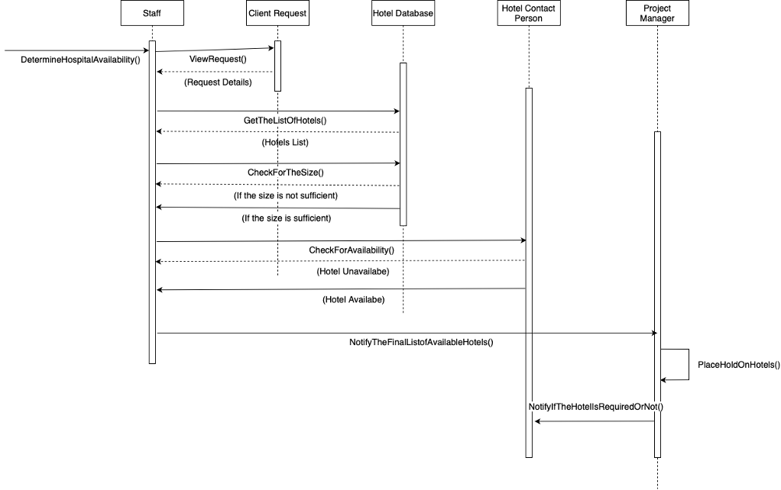
5.4 UML – Sequence Diagram
Determine hotel availability

Slide 18
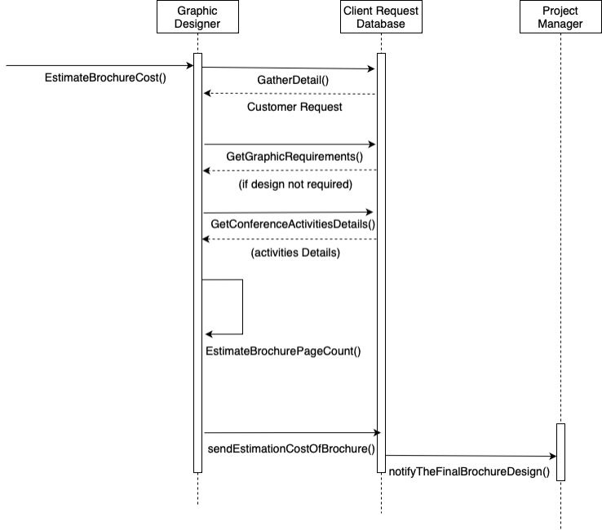
5.5 UML – Sequence Diagram
Estimating brochure cost

Slide 19
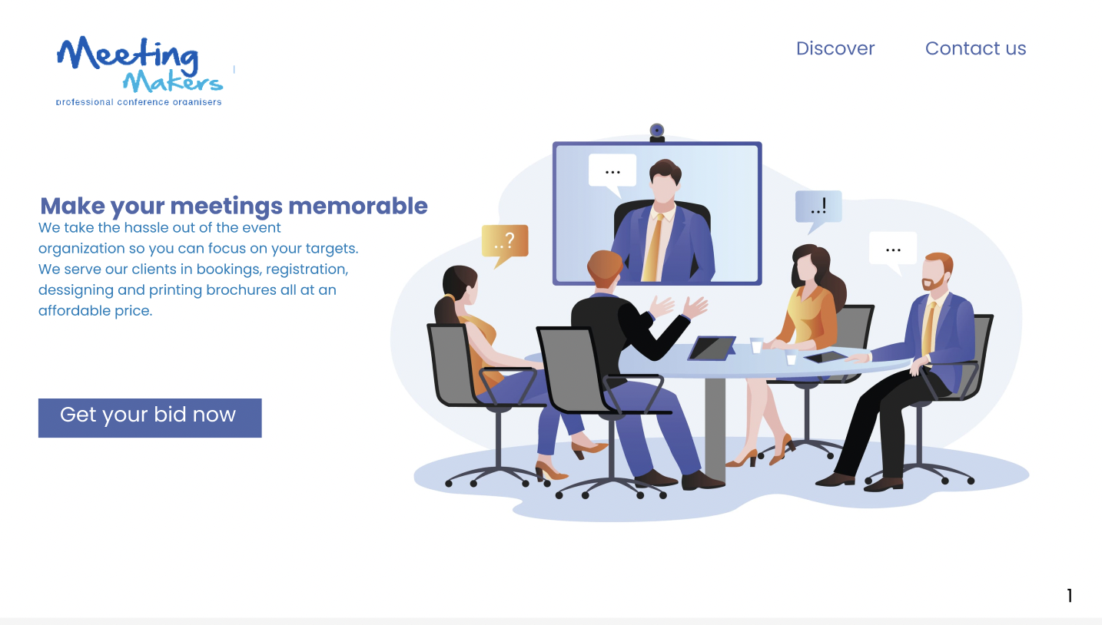
User Interface
Website Home screen

Slide 20
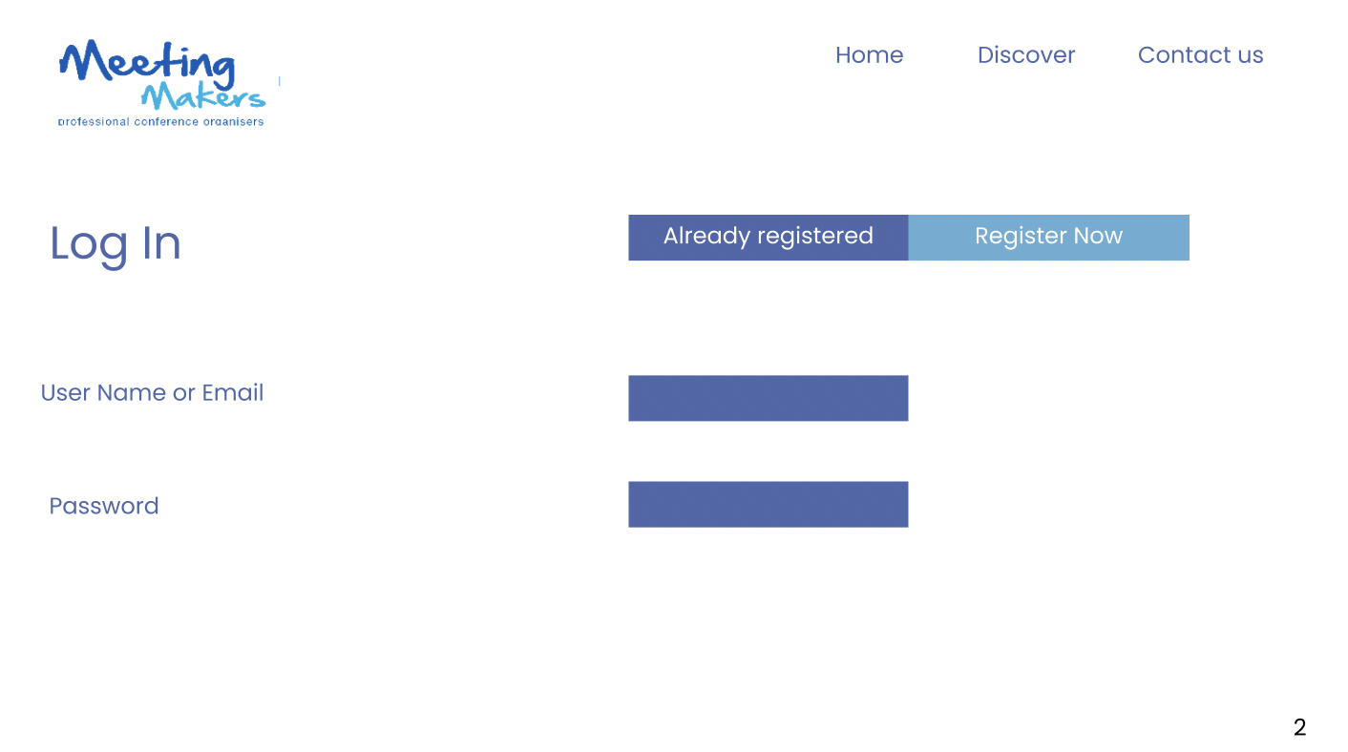
User Interface
User Login Page

Slide 21
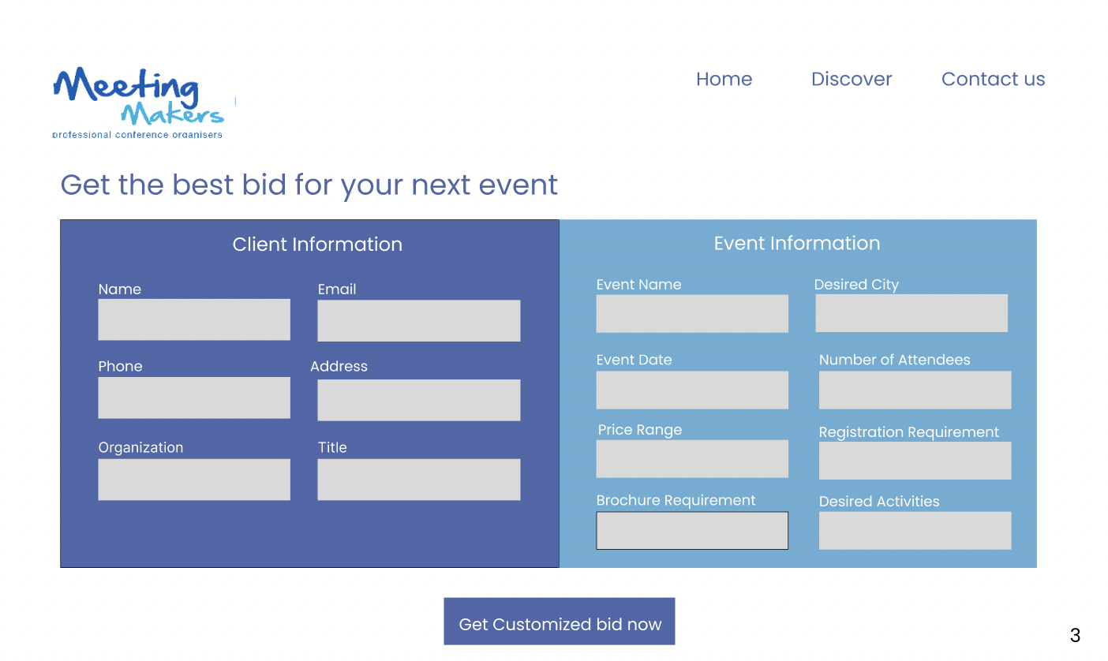
User Interface
Client & Event Information Input screen

Slide 22
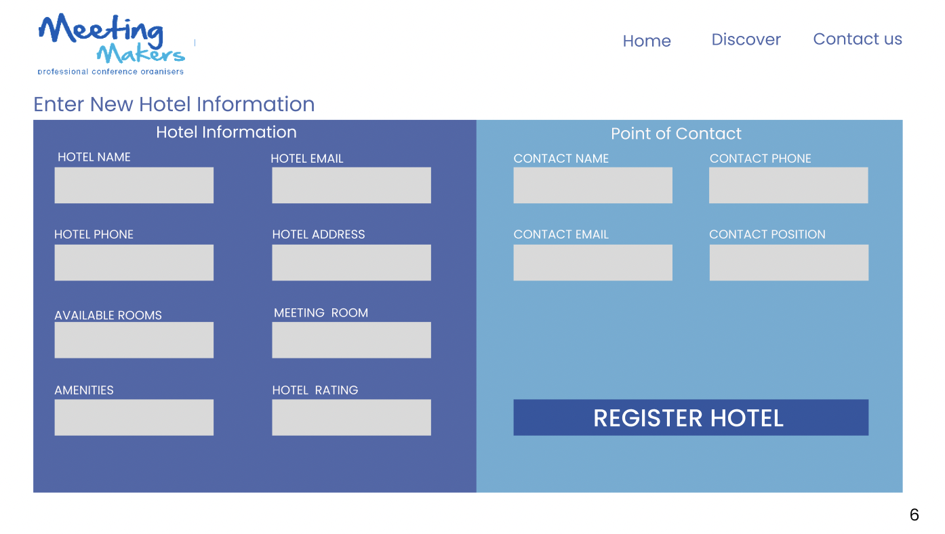
User Interface
Back End Hotel Registration Input Screen

Slide 23
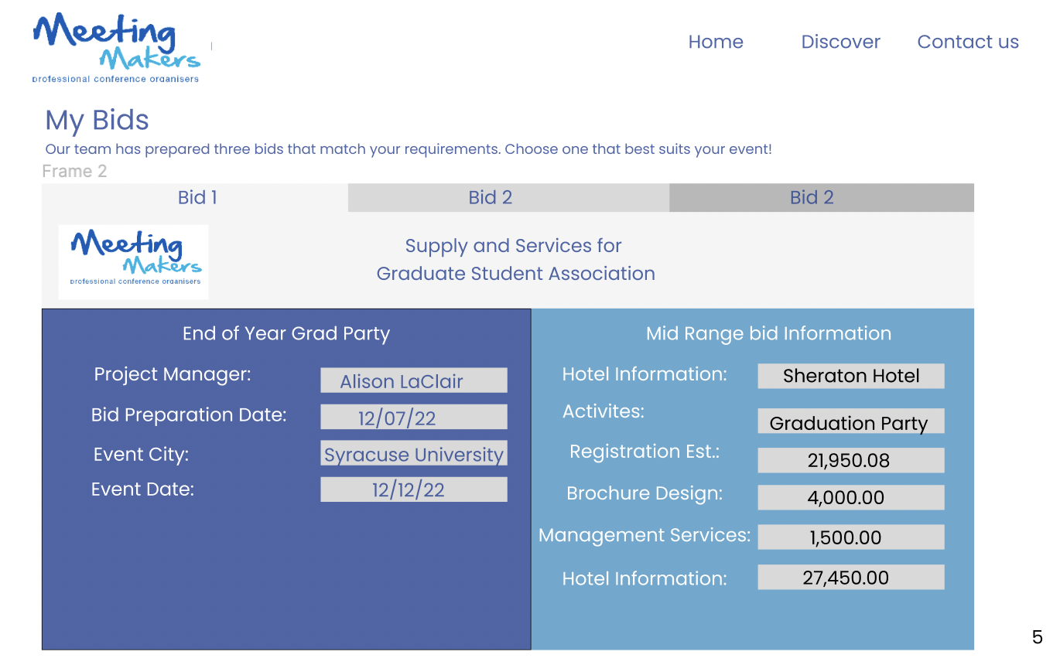
User Interface
Bid Options Screen

Slide 24
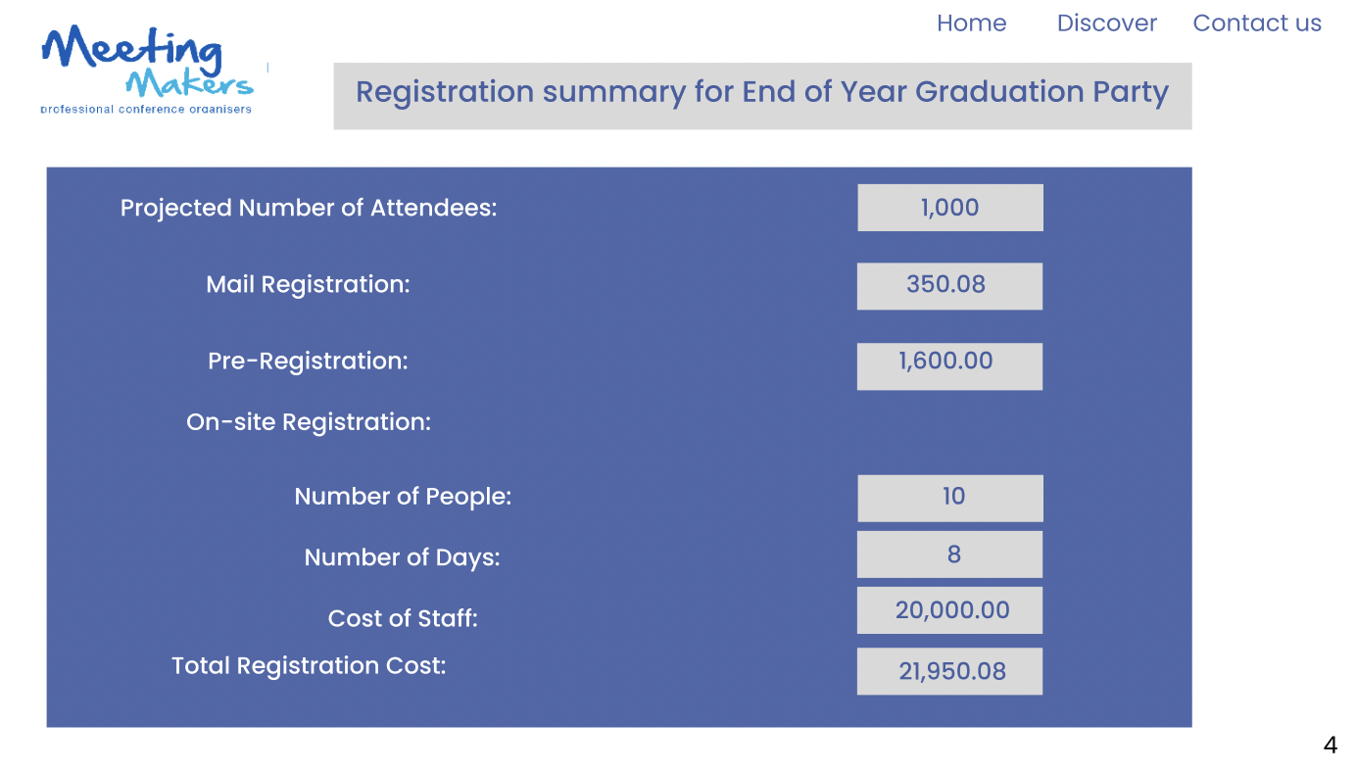
User Interface
Registration Summary Screen

Slide 25
Lessons Learned
How a system analyst performs his task by gathering data and analyzing the data according to the needs of the stakeholders.
The Data flow diagrams also known as the DFD’s gave us a clear idea of the flow of data and what are the essential components of the system.
A key aspect of a project is to check the quality of the finished product and the performance of the system.
Communication is an important factor in a successful project between the team members and the stake holders to understand their point of view and requirements.
Knowing that customer satisfaction is important for a project to be successful.
We also came across various software’s and learned to perform various functions such as Draw.io, Visio, Figma. These enabled us to visualize the system output and system structure. Understanding the different entities and their roles according to the requirements.

Slide 26
Problems and difficulties
Understanding the system requirements and specifically differentiating between the functional and non-functional requirements.
Understanding the current situation and systems of the company and to make our suggestions different from what the company had now.
Building the user interface and state diagrams was a new experienced since we hadn’t done anything similar before.
Each member had a different system flow diagram and understanding each point of view and coming up with a system that all agreed on had its own difficulties.
There were some difficulties in understanding the relations between various entities that can be implemented at the back end.

Slide 27
Experience Gained
The experience of the course has been a great journey as we learned new things and implemented this project by putting our knowledge to use.
Initially we were not aware of so many terms that were introduced at the start of the semester and we all felt a bet overwhelmed by slowly we gained experience in all these skills.
Performing this project had helped us to use the knowledge gained in the class and to get together and learn how to communicate our ideas better and how to function in a team.
This course also taught us new software’s which are always a great plus to have while looking for jobs and open new opportunities.

Slide 28

Thank You

